Slide 1
Signal & Spectral Processing
CPE 381 Foundations of Signals & Systems
for Computer Engineers
Dr. Emil Jovanov

Slide 2
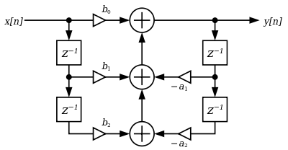
Filter Implementation: Direct Form 1
The most straightforward implementation is the Direct Form 1, which has the following different equation:
Here the b0, b1 and b2 coefficients determine zeros, and a1, a2 determine the position of the poles. Flow graph of biquad filter:
CPE381 Fundamentals of Signals and Systems for Computer Engineers

Slide 3
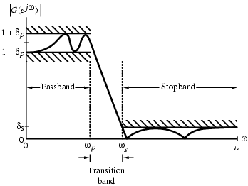
Filter Specification
60dB
4000Hz
1800Hz
CPE381 Fundamentals of Signals and Systems for Computer Engineers

Slide 4
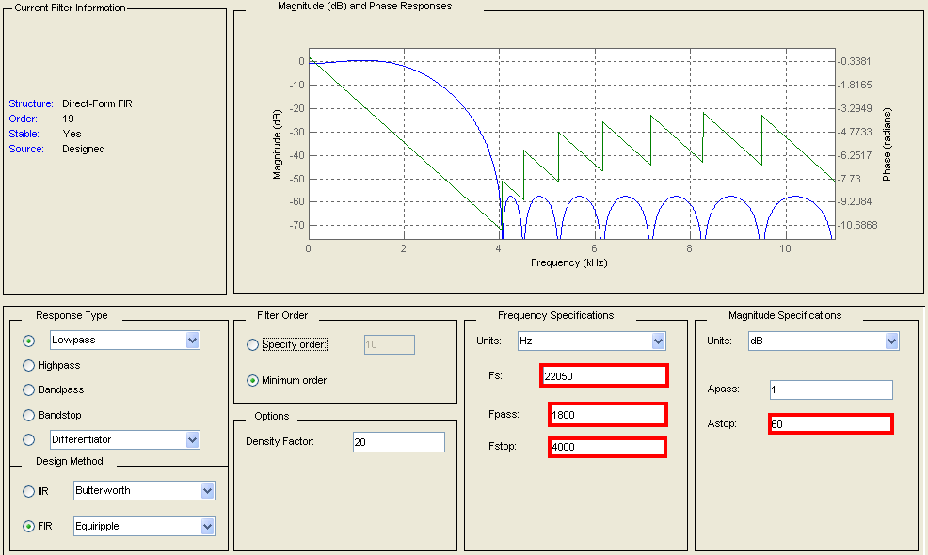
Filter Design – Matlab Filter Design and Analysis Tool

Slide 5
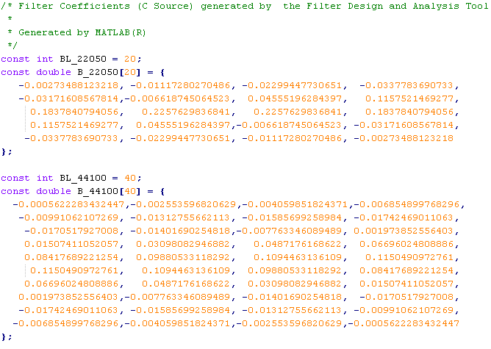
Filter Coefficients
FIR filter coefficients (floating point)

Slide 6
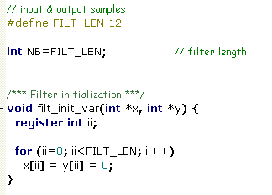
Filtering
0 (now)
Init

Slide 7
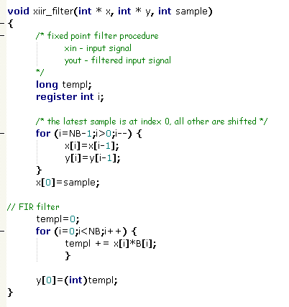
Filtering
FIR filter (floating point)

Slide 8
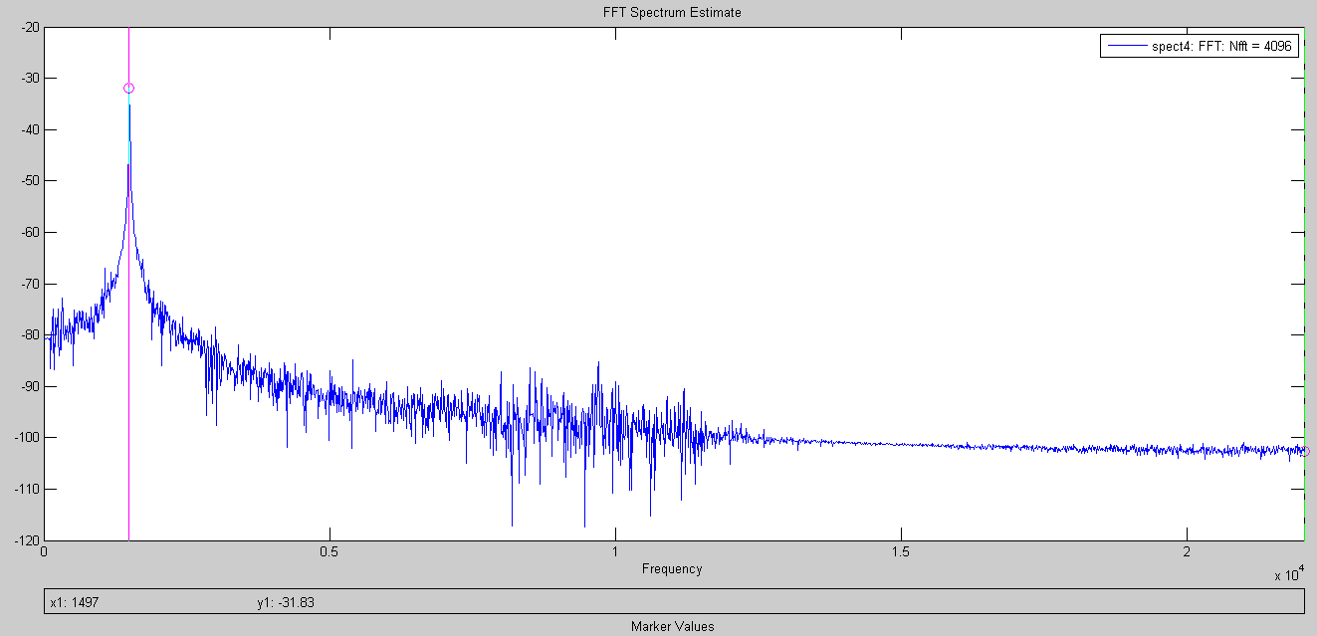
BONUS - Determining the frequency of the added sine wave
FFT Spectrum of the wave file with added sine wave

Slide 9
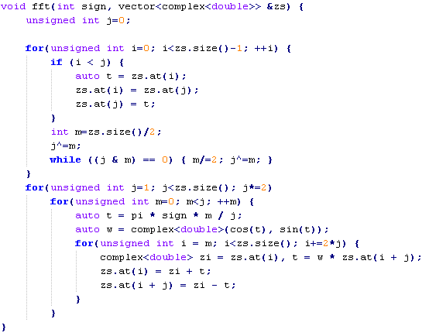
FFT Calculation in C
Many available libraries (e.g.: FFTW.org)
Simple function by Jon Harrop *
* http://stackoverflow.com/questions/10121574/safe-and-fast-fft
9

Slide 10
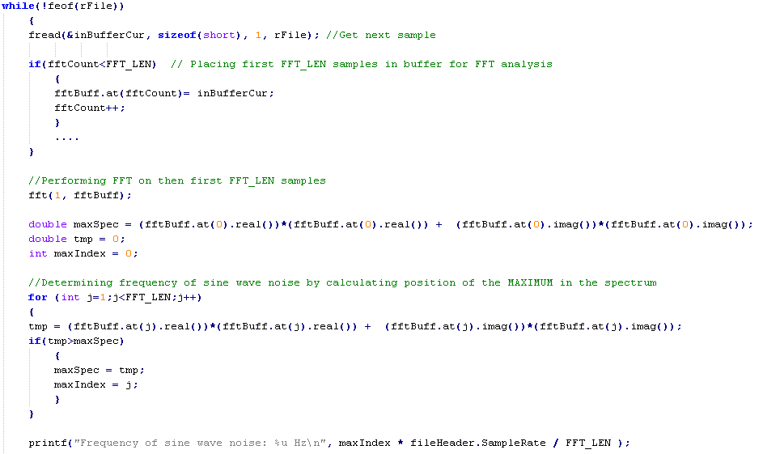
Determining frequency of sine wave noise
Preparing samples for FFT analysis
Performing FFT analysis
Searching position of the MAX in FFT Spectrum
Printing Frequency of the sine wave noise
10

Slide 11
FM modulated Data Transfer
Noise always present
  Consider signal to noise ratio
Example: FM modulated data transmission; Data represented by sine waves with different frequencies
  Digital “0” – sine wave at 1600Hz
  Digital “1” – sine wave at 2000Hz
Challenge – fast and reliable detection each sine wave
11

Slide 12
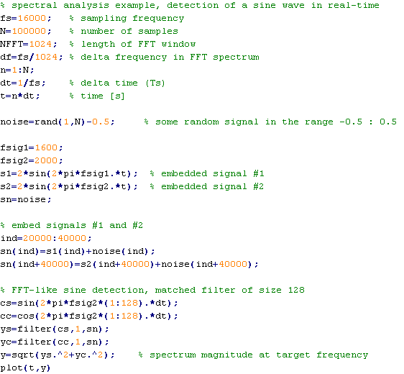
Detection of a sine wave in real-time
Creating always present noise
Embedding signals for “Digital 0” and “Digital 1”
Creating signals for “Digital 0” and “Digital 1”
Creating and applying matching filters
12

Slide 13
Detection of a sine wave in real-time #2
Signal after applying matching filters at 1600Hz
Signal after applying matching filters at 2000Hz
13

